Slide 1

Ellipses
A Unique Opportunity…
Book, Music, & Lyrics by
David Quang Pham
Notes:
Introduction
Good afternoon, everyone. I’m Kim Ruyle, and I’ve had the opportunity to review ELLIPSES, a new work of musical theatre.... I’d like to share with you what excites me about this musical and what makes it so unique… CLICK to transition.
Play music clip.
CLICK to transition. ELLIPSES is by David Pham, and I believe it represents a unique opportunity for producers and the theatre community in general. In the next few minutes, I will tell you what drew me to ELLIPSES and share what I believe makes it so unique. I hope to answer why you, as a producer, should consider this opportunity… why this play… why this playwright… and why now.
Next slide.

Slide 2
Ellipses
A Unique Story
An epic cosmology mythology, ELLIPSES centers on the Galaxy family and their quest to undo the Big Bang, after their dog Gravity sets it off. This coming-of-age musical follows a young adult and their dog running away from home.
Book, Music, & Lyrics by
David Quang Pham
Notes:
Overview
Read the synopsis.
ELLIPSES is a story about togetherness, isolation, about family and an astronomical adventure.
NEXT SLIDE

Slide 3
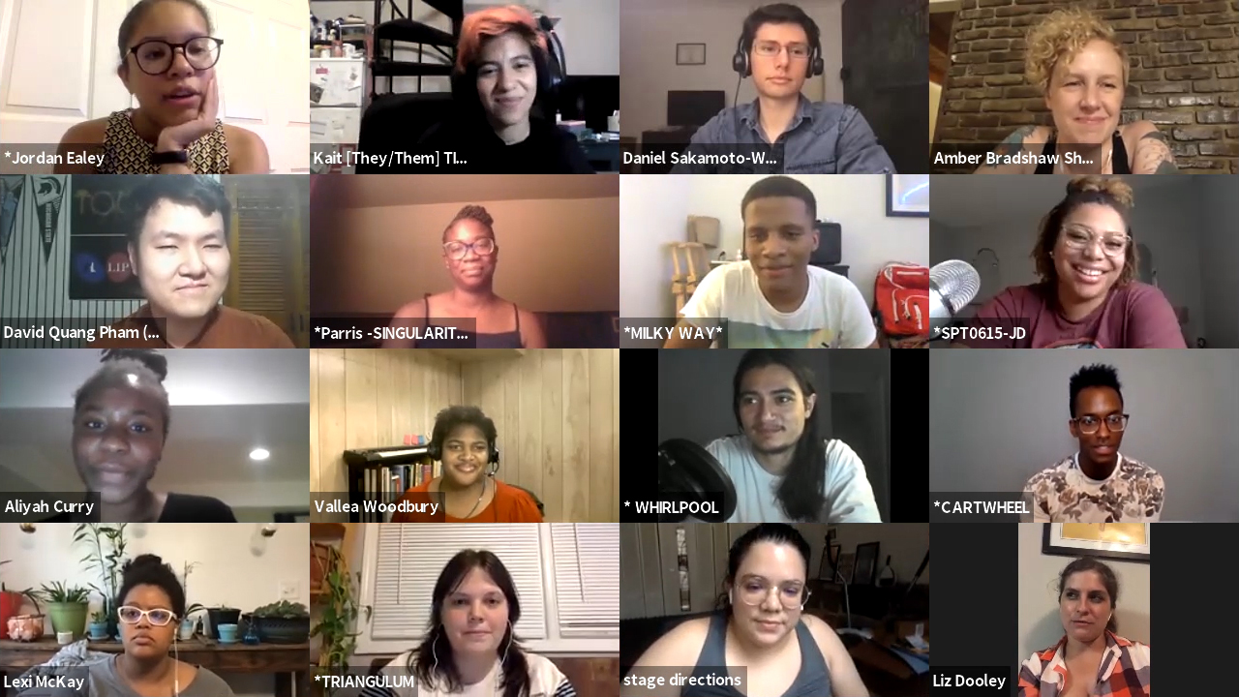
Ellipses
A Diverse Cast of 8 or more
Simple Orchestra Requirements
Eclectic Mix of Music Styles
Book, Music, & Lyrics by
David Quang Pham
Notes:
About the Musical
The theatrical reading that I viewed had a very young, energetic, talented, and diverse cast
Instrumentation might be as simple as a piano, guitar, bass guitar, and drum kit
There’s also diversity in the music which ranges from operatic to pop to metal to experimental
NEXT SLIDE

Slide 4

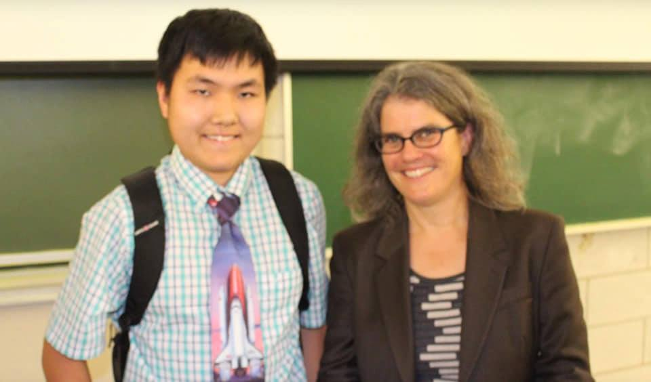
Ellipses
A Unique Playwright
o Background
o Roots in Opera
o Education
o Professional
Book, Music, & Lyrics by
David Quang Pham
Notes:
o David is a Vietnamese-American who connects Eastern and Western art forms – this perspective contributes to his choices about story and music.
o David grew up listening to opera and has written a subatomic opera, a story about particles going to college, called TOUR, which was a 2020 Downtown Urban Arts Festival finalist. He is also the composer-lyricist on a musical called PARALLEL UNIVERSITY with two other collaborators for New York Public Library for the Performing Arts and their virtual reality program.
o David obtained his Bachelor of Science in Astrophysics and a Minor in Theatre from Michigan State University. During his sophomore year, he got a chance to studied under Dr. Andrea M. Ghez, 2020’s Nobel Prize in Physics laureate.
o He is a member of ASCAP, the Dramatists Guild, OPERA America, and ΣΠΣ, an honor society in physics. Further, David is the Literary Fellow for the Playwrights Foundation in San Francisco.
o David is a unique individual and has written a unique musical, a light opera, that incorporates the Big Bang, Gravity, Time, and Space in a story about family.
NEXT SLIDE

Slide 5
Ellipses
A Unique Message
ELLIPSES is a light opera delivered in the language of Science.
One doesn’t have to speak Italian to appreciate Puccini’s La bohème. And you don’t have to be an astrophysicist to appreciate Ellipses because everyone has a family.
Book, Music, & Lyrics by
David Quang Pham
Notes:
Here’s what really excited me about David’s work…
READ MESSAGE
NEXT SLIDE

Slide 6
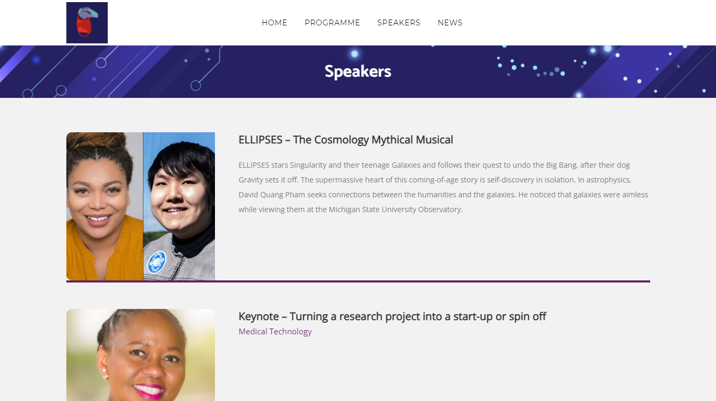
Ellipses
Development
o 2020 — 2021: Working Title Playwrights New Play
Development and Dramaturgy Apprenticeship
o Multiple Readings with Talkback
o July 2021: Concert Reading with Talkback
o 2021 — Ongoing: TRU Workshops
o 2021: Durban University of Technology
Book, Music, & Lyrics by
David Quang Pham
Notes:
o August 2020 — July 2021: Working Title Playwrights New Play Development and Dramaturgy Apprenticeship
o October 2020 – May 2021: Multiple Readings with Talkback
o July 2021: Concert Reading with Talkback directed by Aliyah Curry
o June 2021 — Ongoing: Theater Resources Unlimited Workshops
o June 2021: How to Write a Musical That Works – Part One: The World & the Want Workshop
o October 2021: How to Write a Musical That Works – Part Two: Conflict & Obstacles Workshop
o In the coming days, David and Daniela Cobb, the actress who has been portraying his protagonist and a Broadway performer on The Lion King, are speakers at the Durban University of Technology’s Annual Research Conference. This university in South Africa has been showcasing their songs to their Faculty of Arts and Design throughout the past summer.
NEXT SLIDE

Slide 7
Ellipses
Next Steps
o OPERA America IDEA Opera Grant
o Grant is for $12,500 (currently one of ten finalists)
o Atlanta Musical Theatre Festival
o Will need producer and ~$4,000 financing
for full reading
Book, Music, & Lyrics by
David Quang Pham
Notes:
IDEA – Inclusion, Diversity, Equity, and Access
David is one of ten finalists from which two will be selected for development
David is working with affiliates at the University of Maryland on this grant and shooting for a venue In Washington, DC, for a three-day staged/theatrical workshop
David is also applying to the Atlanta Musical Theatre Festival – because of his work with Working Title Playwrights, he’s well-connected with the theatre community in Atlanta. For this opportunity, David needs some financing.
NEXT SLIDE

Slide 8
Ellipses
Unique!
“I love stories about families and yours
is truly the most unique I've seen.”
John Mabey, Award-Winning Playwright
Book, Music, & Lyrics by
David Quang Pham
Notes:
Why Now?
Our world has been turned upside down over the past year and a half. Families have been separated – torn apart in some cases. There is controversy and confusion swirling about science and the politicization of science. The world needs a story about family. About the importance of connections, of relationships. The world needs to understand and embrace Science. The world needs ELLIPSES is about family. ELLIPSES is unique. It represents a unique opportunity for producers. Thank you very much for your consideration.
QUESTIONS?

Slide 9
Ellipses
A unique musical…
An epic cosmology mythology…
A coming-of-age story…
Book, Music, & Lyrics by
David Quang Pham
Notes:
CLICK to transition.
ELLIPSES is a unique musical that blends

